Slide 1
SoSe 26 – M&A as Transformer of Automotive Industry
Introduction to Valuation – The case of Traton SE
Prof. Dr. Mark Wahrenburg
1
Notes:
1

Slide 2

Traton SE
Traton SE is a global commercial vehicle manufacturer and holding company
Brands: Scania, MAN, International, and Volkswagen Truck & Bus
Founded in 2018 (renaming of Volkswagen Truck & Bus)
2019: IPO on Frankfurt and Stockholm stock exchanges
2021: Acquisition of Navistar completed (International integration)
Focus on trucks, buses, and light-duty commercial vehicles
Industrial logic: scale, modular platforms, and global sourcing
Large installed base supports parts and services cash flows
2025 sales revenue: EUR 44.1 bn (source: Traton factsheet)
As of Jun 2026: ~107k employees and market cap ~EUR 16.15 bn
Long-term strategy: Transforming Transportation Together

Slide 3
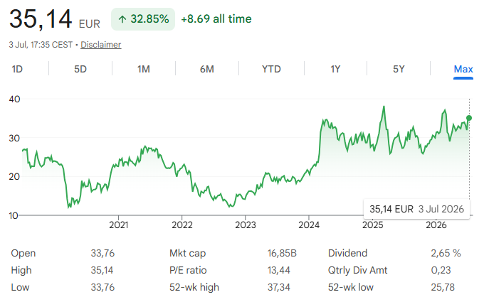
Is Traton correctly valued by the market today?

Slide 4
Introduction to Valuation
DCF Valuation
Multiples
Football Field
1
2
3
4

Slide 5
DCF Valuation
1
Free Cash Flow to the Firm
WACC
Equity Bridge
Sensitivities
5

Slide 6
DCF Analysis by Professionals
Fundamental valuation of Continental results in a FV of €46.7bn and an EV of €38.0bn considering a WACC of 10% and a perpetuity growth rate of 3%. Additional upside could be realized if synergies would be considered.
Financial Summary
Source: Company Information, Bloomberg, FactSet as of August 26, 2014.

Slide 7
From Revenues to Cash Flow
Income Statement
 | Revenues
- | COGS
- | SG&A
= | EBIT
+ | Dep
= | EBITDA
Need to forecast
CF Statement
Cash Adjustments
- | Taxes (= t x EBIT)
- | ∆NWC
- | CAPEX
= | FCFF
7

Slide 8
Some possible (extremely) simplifying assumptions
Revenues: Assume growth of a% (based on historical revenues or analyst forecasts). Is a% growth realistic forever? Convergence?
COGS & SGA: b% of revenues
Net working capital: c% of revenues
CapEx: d% of revenues
Depreciation: e% of revenues / e% of capex (the latter should converge to 1 for TV)
Constant rate or increasing/decreasing over the planning horizon
8

Slide 9
Forecasting issues
Analyze and recognize industry trends
Be aware of analyst‘s forecasts (reveues, earnings, EBITDA..)
Remember: Management forecasts are likely to be biased
Compare firm to industry averages
Consider business cycle effects and current business cycle position

Slide 10
Choice of the Tax Rate
Marginal tax rates are the statutory tax rates (on profit) or: Effective tax rates are the tax rates that companies actually pay
Effective rates are often significantly lower than marginal rates, as companies use all (legal) possibilities to avoid / postpone tax payments.
Firms with international operations pay different tax rates in different countries.
Which tax rate to use? Argument:
Tax payments to avoid / postpone does not work forever → Marginal rates preferable
Use for our case: 30% (data source: KPMG corporate tax rate table for GER)
For international companies, the tax rate of the registered office is usually used
see DePamphilis (2014): Mergers, Acquisitions, and Other Restructurings Activities, Chapter 7.

Slide 11
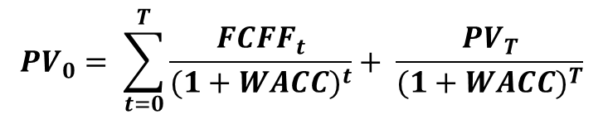


Present Value of the FCFF
t₀ t₁ t₂ t₃ ... T T+1 ...........
For the first T years (often 5, 10 or 15) cash flows are projected based on detailed forecasts.
All Cash Flows after T are summarized in a „residual value (RV)“ to be realized in a hypothetical sale in T, based on three options:
Gordon Growth model
Exit Multiple, e.g. ${PV}_{T}$ = EBITDA_{T} * EBITDA-Multiple
“The average terminal growth rate for corporations should be similar to the long run average GDP growth rate (1%-3%)”
$${PV}_{T}=\frac{{FCFF}_{T+1}}{WACC−g}$$
$${PV}_{0}= \sum_{t=0}^{T}{\frac{{FCFF}_{t}}{{(1+WACC)}^{t}}}+ \frac{{PV}_{T}}{{(1+WACC)}^{T}}$$
Firm value in t₀ :
11

Slide 12

Determine the WACC
E = Market value of equity
D = Market value of debt → Usually, book value is taken
r_{E} = Cost of equity
r_{D} = Cost of debt → Cost of debt outstanding, no historical cost
t = Statutory tax rate
Important: E is the market value of equity, not book value (“Circularity problem”)
Important: E/(E+D) is the target (future) capital structure
$$WACC=r_{E} ∗ \frac{E}{\left(E+D\right)} +r_{D}\left(1−t\right)∗\frac{D}{\left(E+D\right)}$$
12

Slide 13
Determine Cost of Equity
Capital Asset Pricing Model:
r_{E} = r_{F} + ß (E(r_{m} ) - r_{F} )
r_{F} = Risk free rate
ß = Beta (the systematic / non-diversifiable risk of the company).
(E(r_{m} ) - r_{F} ) = Market risk premium
see DePamphilis (2014): Mergers, Acquisitions, and Other Restructurings Activities, Chapter 7.

Slide 14
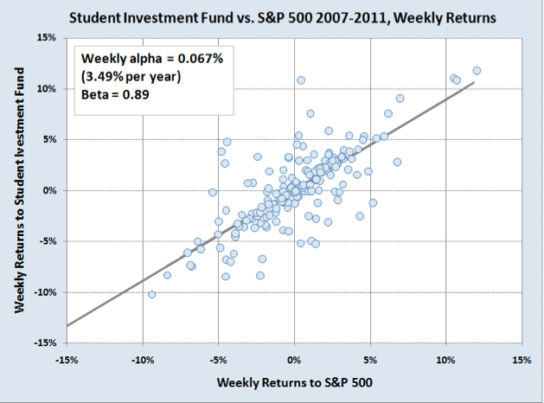
Equity Beta
Beta is usually calculated by regressing the stock returns on the market index return
Needs a sufficient stock history
Available also online (e.g. yahoo finance)
Choice of a market index required

Slide 15
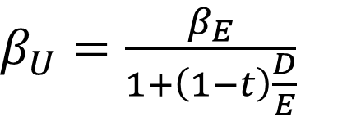
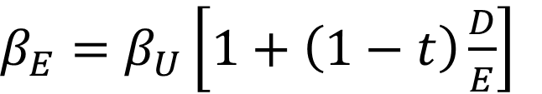
Alternative: Estimate Beta from peer firms
Problem: Beta depends on debt level of the company.
Solution:
$β_{U}=$ $\frac{β_{E}}{1+\left(1−t\right)\frac{D}{E}}$
Unlever beta of peers → find ß_{U}
Determine average ß_{U} of relevant peers
Relever to target leverage ratio of the company being valued. → find ß_{E}
$β_{E}=$ $β_{U}\left[1+\left(1−t\right)\frac{D}{E}\right]$
ß_{U} = unlevered beta, ß_{E} = levered beta
t, D, and E: tax rate, debt and equity

Slide 16
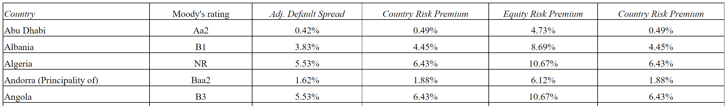
Market Risk Premium
The market risk premium is usually estimated based on long-term historical data.
Country-specific data is often used. For our case, the premium is already specified in the template: 4.23%.
Source: Damodaran Country Default Spreads and Risk Premiums
Source: Damodaran, 2026

Slide 17
Equity Bridge - Overview
PV_{FCFF}
"The PV of the operating assets which generate the forecasted FCF"
PV_{FCFE}
Financial Debt
Minority Interest
Preferred Stock
Non operating assets (NOA) - cash & securities
- minority stakes
(“Investment in associates”)
Non operating liabilities (e.g. pension liabilities)

Slide 18
Equity Bridge - Overview
The Cash Flows forecasted are the cash flows from operating assets & liabilites only.
All other assets and liabilities are added / subtracted in the „equity bridge“
How can operating and non operating assets be separated? (look carefully at the financial statement: are the revenues from normal operations or from holding securities? Are costs related to operations or are they (non operating) pension payments?
What is the appropriate value? (Book value of pension liabilities often smaller than market value…)

Slide 19
Sensitivities
The result of the DCF model varies greatly with its assumptions, in particular WACC and terminal growth rate
Question: How does the valuation change when these are adjusted?
19

Slide 20
Multiples
2
Example
Selection of multiples and peers
20

Slide 21
Comparable Companies analysis by professionals
Continental currently trades at a FV/EBITDA 2014E multiple of 7.9x and a P/E 2014 multiple of 12.1x, with FV/EBITDA slightly above peers and P/E below peers.
Trading Multiples for Automotive Suppliers
Source: Company Information, Broker Research, Factset as of August 26th ,

Slide 22
Comparable Companies analysis by professionals
Continental currently trades at a FV/EBITDA 2014E multiple of 7.9x and a P/E 2014 multiple of 12.1x, with FV/EBITDA slightly above peers and P/E below peers.
Trading Multiples for Automotive Suppliers
Which multiples are relevant?
One multiple for the whole firm or two separate multiples for the sesgments?
Which peer group fits?
Source: Company Information, Broker Research, Factset as of August 26th ,

Slide 23
Multiples: Example
Due to the weaknesses of individual valuation methods, a company valuation should never be carried out exclusively using a model.
Example: There are 3 competitors A, B and C with the following multiples:
Multiple | Co. A | Co. B | Co. C | Avg.
(D+E)/EBITDA | 5.5 | 7.0 | 6.4 | 6.3
(D+E)/Sales | 1.1 | 1.3 | 1.6 | 1.3
E/Net Income | 18.0 | 24.0 | 22.0 | 21.3

Slide 24
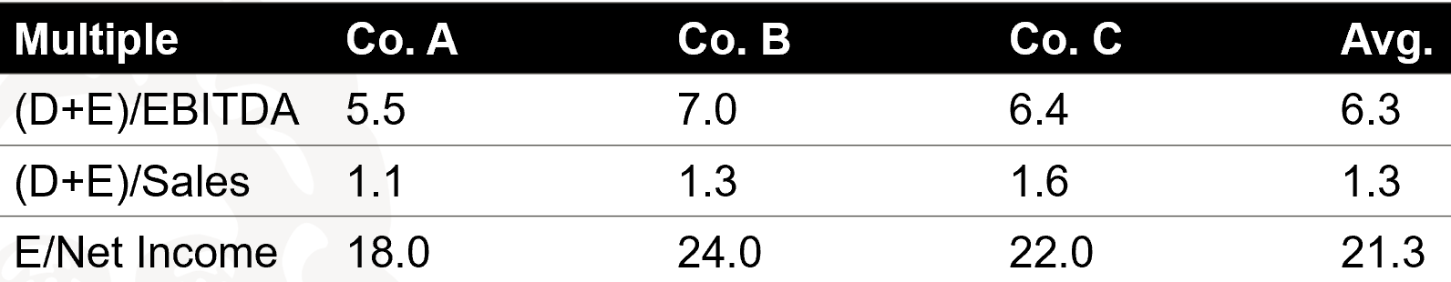
Multiples: Example cont.
The goal is to value company Z. Assumption: Debt of Z: € 5,000.
Accounting metrics of Z |  | Implied Equity Values for Company Z
Multiple |  | High | Low | Avg.
EBITDA | €1,800 | €7,600 | €4,900 | €6,340
Sales | €10,000 | €11,000 | €6,000 | €8,000
Net income | €500 | €12,000 | €9,000 | €10,650
It is not uncommon for a multiples valuation to vary greatly between selected peers and multiples.

Slide 25
Multiples: Procedure
Select multiples
What multiples are used / are useful for this industry?
P/E ratio and other equity multiples only make sense if leverage is similar.
Select peers
Similar cash flow characteristics, risk, growth rates, ...
Similar region, market, products, business model, cost structure, size, ownership structure, capital structure, accounting standards, R&D intensity, ...
At best, no 'special effects' - e.g., major litigation, post-merger integration, ongoing acquisition, ...
If necessary, standardize peer group metrics
Unification of accounting standards
Standardization of reporting standards, e.g. 'year ends' etc.

Slide 26
Typical multiples
Equity multiples
Equity Value-to-Net Income
Equity Value-to-equity Cash flows
Equity Value-to-book Value of equity
Firm value multiples
Firm Value-to-Sales
Firm Value-to-EBITDA
Firm Value-to-EBIT
Firm Value-to-Operating Cash Flow
Firm Value-to-Book Value of Assets
Multiple valuations are based on forecasts for the next 1-2 years, not on historical values
The choice of multiples depends on the industry and company situation

Slide 27
Multiples: Advantages and disadvantages
EV/Sales Pro | EV/Sales Con
Possibly the only option if EBITDA < 0 | Sales are a weak indicator of value / profitability
Good for industries where market share plays a major role | No statement about risk
Easy to calculate
Not strongly influenced by accounting standards
P/E Pro | P/E Con
Easy to understand | Not applicable for negative earnings
Widely used | Accounting standards and regulation not always the same
Easy to calculate | Depends on capital structure
EV/EBITDA Pro | EV/EBITDA Con
EBITDA is similar to FCF | Ignores taxes
Nicely comparable between companies with similar capital structure | Ignores depreciation and CapEx
Not strongly influenced by accounting standards

Slide 28
DCF & Multiples: key takeaways
DCF: Which B/S, P&L, CFS positions do I need? How to forecast revenues / costs / earnings? How to forecast CapEx & change in working capital? What is a realistic long-term growth rate? How do I forecast the revenue? What is the cost of capital? What are important inputs (sensitivities)? What do I need to consider for the equity bridge?
Multiples: What are relevant peers? What are relevant multiples? Which year?
28

Slide 29
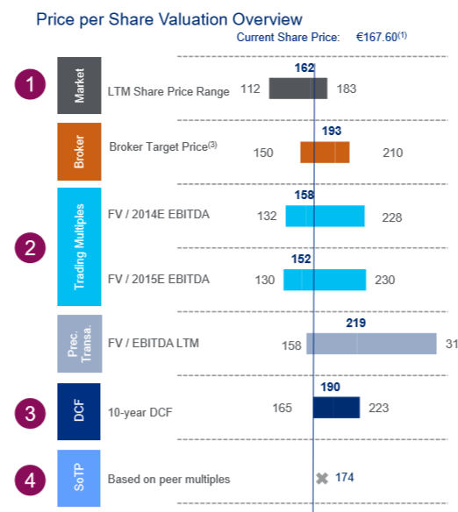
"Football Field”: Display your results
3

Slide 30
Assignment
Task: Value Traton SE for the valuation & reporting date 30/6/2026.
Suppose that you conduct this valuation for June 30, 2026 based on the information available at that time.
You receive a package of relevant data and an assessment template on OLAT. Additional web research can be necessary.
The objective is to perform both a DCF and a multiple valuation and to compare the results with the market valuation. (All details once again in assignment available on OLAT)
30

